Slide 1
GITHUB Introduction

Slide 2
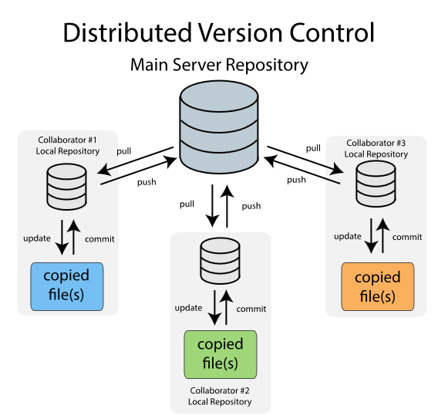
Distributed Version Control System

Slide 3
Contd..
In distributed VCS, each client (referred as collaborator) has its own local repository and will work on its local repository for the most part.
Each collaborator will have the complete repository on his local machine i.e. the complete revision history, all the branches, tags, commit information is present on the local machine.
In distributed VCS, clients don’t just check out the latest snapshot of the files; rather they fully mirror the repository. Thus if any server dies, and these systems were collaborating via it, any of the client repositories can be copied back up to the server to restore it. Every clone is really a full backup of all the data.
Terminology used in distributed VCS
Push: Send a change to another repository (may require permission)
Pull: Grab a change from a repository

Slide 4
Advantages of distributed version control systems
FAST
Cheap branching and merging
Local branching
Simple and productive tool
Scalable
Open source

